Slide 1

Machine Learning Algorithm – Today’s session
Supervised Learning
Unsupervised Learning
Linear Regression
Logistic Regression
Decision Trees
Random Forest
SVM
kNN
Naïve Bayes
Neural Nets
k-Means
Hierarchical Clustering
Recommender Systems
08
02

Slide 2
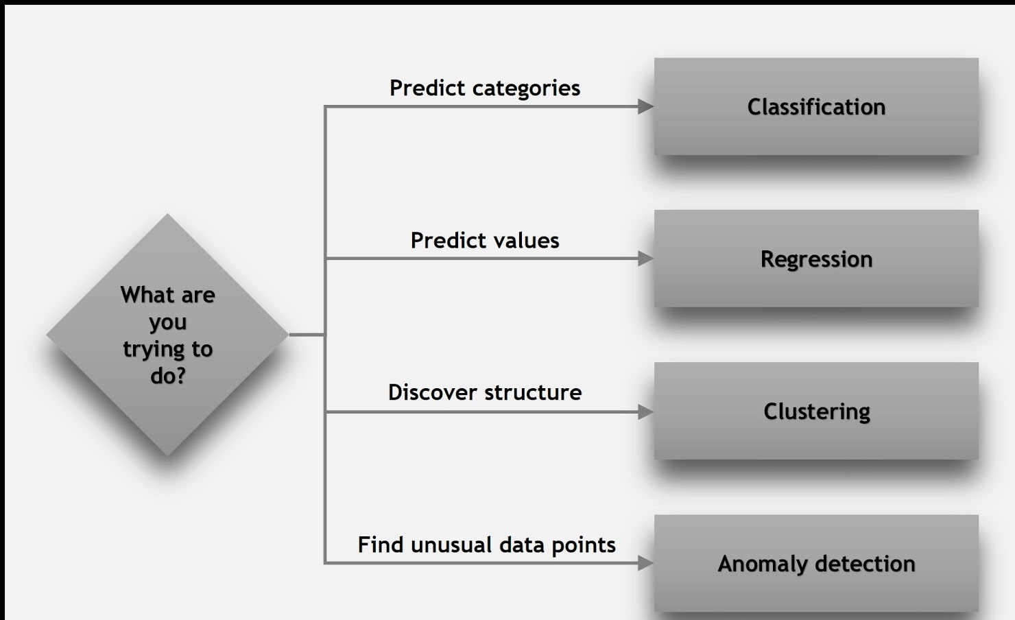
09
01

Slide 3

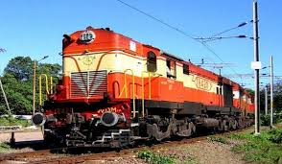


Supervised Learning- Regression
How many hours will battery last
Will the battery last till end of the day
How many seats are available 10 days prior to journey
Can I get a confirmed ticket for booking 10 days in advance
How many minutes will the flight be delayed
Is flight on time
10
04

Slide 4
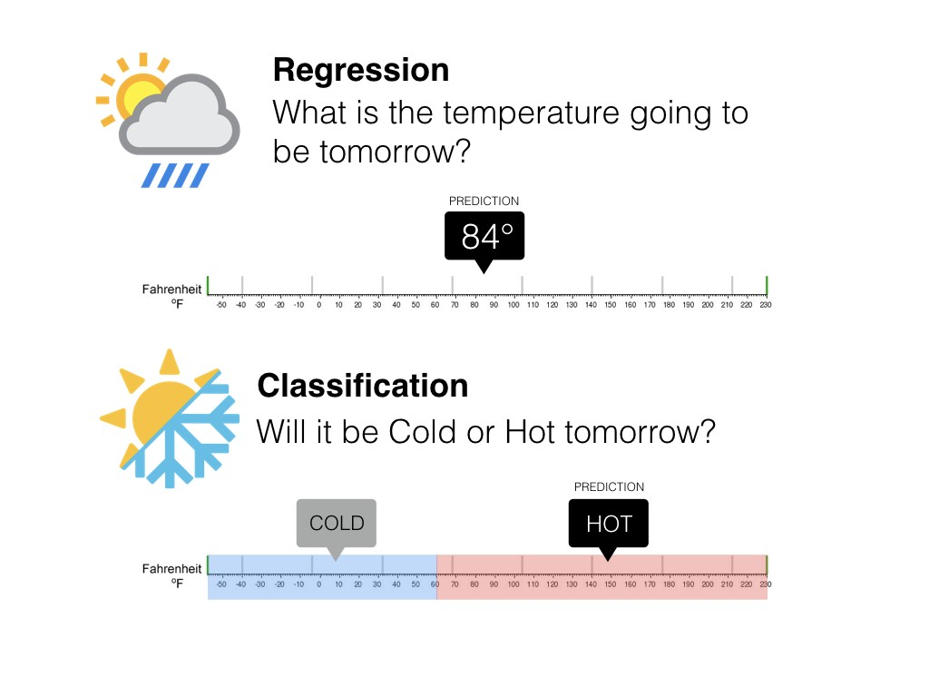
Quick Check – Regression or Classification
11
05

Slide 5
Linear Regression
Univariate and Multivariate
12
07

Slide 6
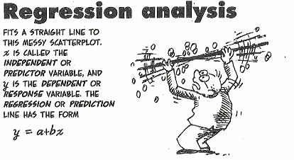
Regression Analysis
Used when you want to predict a continuous dependent variable from a number of independent variables.
Dependent variable must be continuous for Linear regression, if it is categorical then we apply logistic regression.
The independent variables used in regression can be either continuous or categorical.
Simple linear regression analysis means “fitting a straight line to data”
We want to estimate Y at some specific values of X_{i}
14
08

Slide 7
What is Linear?
Remember this: Y=mX+c ?
y
y
y
B
B
B
N
A
A
A
Desired Value
x
x
x
Expected value of y at given level of x =
15
09

Slide 8
Prediction With Linear Regression
If you know something about X, this knowledge helps you predict something about Y.
Equation for prediction value:
Outcome variable
Intercept
y
Slope
Y_{i} = β₀ + β₁*x_{i} + random error
N
B
Predictor variable
Fixed – exactly on the line
Follows a normal distribution
A
x
16
10

Slide 9
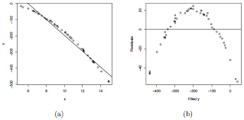
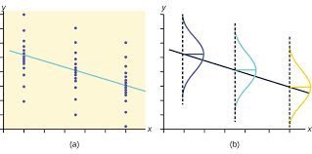
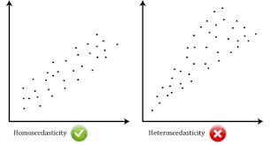
Linear regression assumptions
1. The relationship between X and Y is linear
3. Y is distributed normally at
each value of X
2. The variance of Y at every value of X is the same
17
11

Slide 10
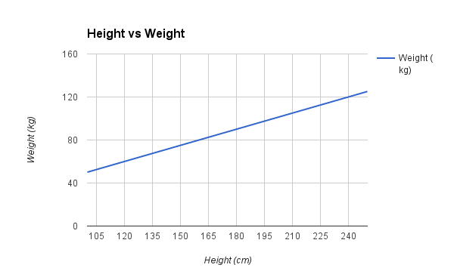
Relationship Between Study Variable & Explanatory Variable
In the figure left , the regression Line indicates positive correlation between Height & weight that is if height increases weight also increases
18
07

Slide 11
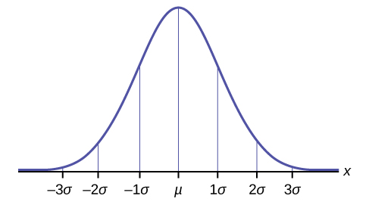

Normal Distribution
The Normal Distribution has:
mean = median = mode
symmetry about the center
50% of values less than the mean and 50% greater than the mean
19
07

Slide 12
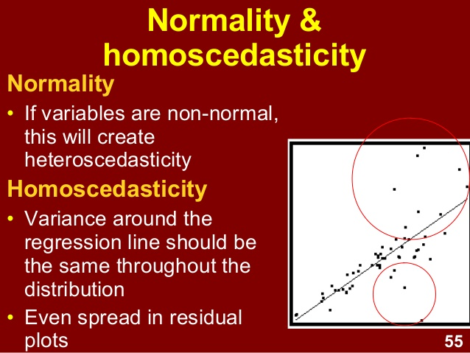
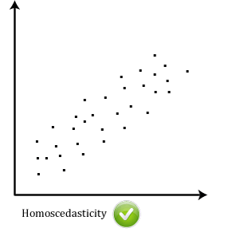
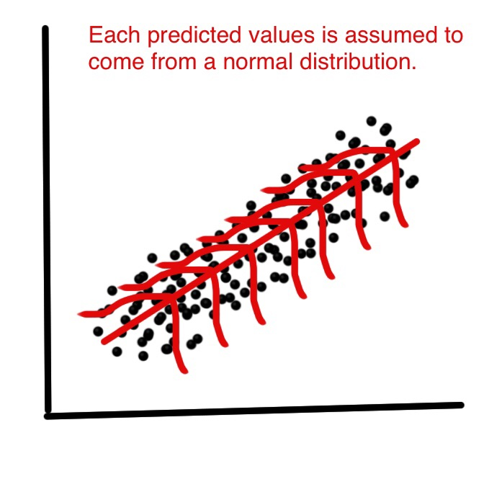
Normal Distribution & Homoscedasticity
20
07

Slide 13
Quick Recap
Machine Learning(Supervised & Unsupervised)
Linear Regression
Equation of Linear Regression
Assumptions of Linear Regression(Linear Relationship, Normal Distribution & Homoscedasticity)
21
05

Slide 14
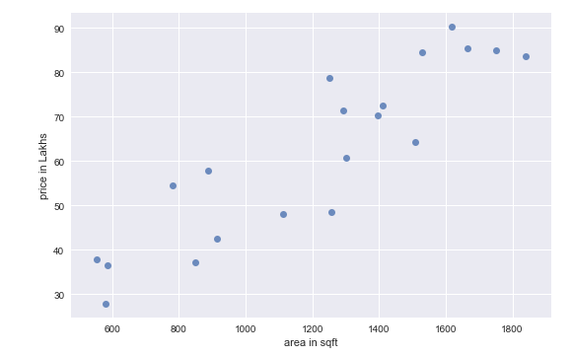
Defining the Criterion: (Area in sq.ft vs. Price in Lakhs)
error (e) = Price - (m * Area + c)
Goal : Minimize Error
e₃
e₃
e₄
e₃
e₄
Which error to be minimized:
Sum of Errors :
Sum of Absolute Errors:
Sum of Squared Errors:
e₄
e₁ + e₂ + e₃ +e₄ + …..+ e_{n}
e₂
e₂
e₂
e₁
|e₁|+|e₂|+|e₃|+|e₄| + ...+ |e_{n}|
e₁
e₁
e₁² + e₂² + e₃² +e₄² + …..+ e_{n}²
Machine Learning here is identifying optimal m & c for the data
27
17

Slide 15
Which error criterion to use
Actual = [ 6 10 14 18]
Predicted = [ 7 9 16 16]
Error = Actual – Predicted = [-1, 1, -2, 2]
Sum of Errors = -1 + 1 - 2 + 2 = 0
Sum of Absolute Errors = 1 + 1 + 2 + 2 = 6
Sum of Squared Errors = 1 + 1 + 4 + 4 = 10
Try for different values of m & c choose the line that minimizes the error
28
18

Slide 16
Deep Dive : Sum of Absolute Errors
Intuitively the green lines looks the best approximation for the data
Price
However the sum of absolute errors is same for all the lines
Sum of Absolute Errors has multiple optimal solutions and mathematically elegant
Area
NOT USED IN PRACTICE
29
19

Slide 17
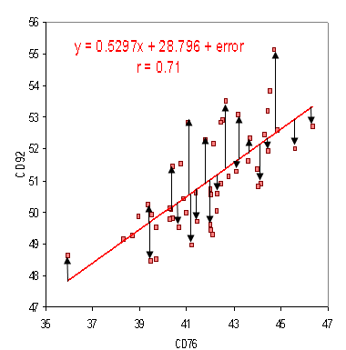
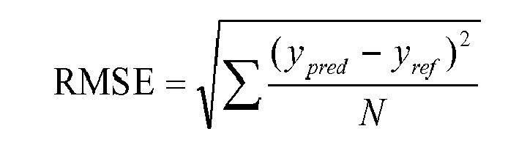
RMSE
Root Mean Square Error (RMSE) is the standard deviation of the residuals (prediction errors). Residuals are a measure of how far from the regression line data points are; RMSE is a measure of how spread out these residuals are. In other words, it tells you how concentrated the data is around the line of best fit. Root mean square error is commonly used in climatology, forecasting, and regression analysis to verify experimental results.
30
05

Slide 18
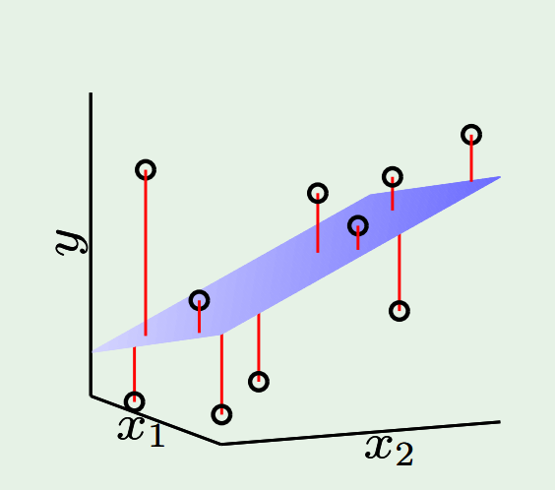
Defining the Criterion: Two factors/inputs/attributes
Goal : Minimize Error
error (e) = Price - (m1 * x1 + m2 * x2 + c)
Which error to be minimized:
Sum of Squared Errors:
Minimize e₁² + e₂² + e₃² +e₄² + …..+ e_{n}²
Machine Learning is identifying optimal m1, m2 & c for the data
31
20

Slide 19
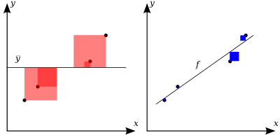
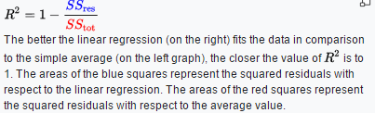
R-squared Explained
https://en.wikipedia.org/wiki/Coefficient_of_determination
32
21

Slide 20
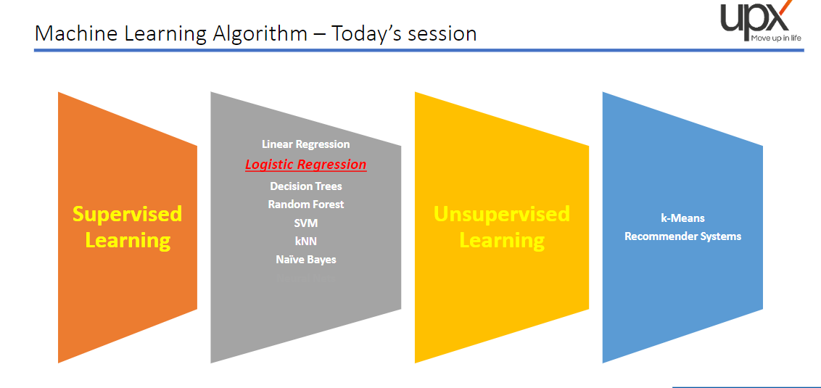
22

Slide 21
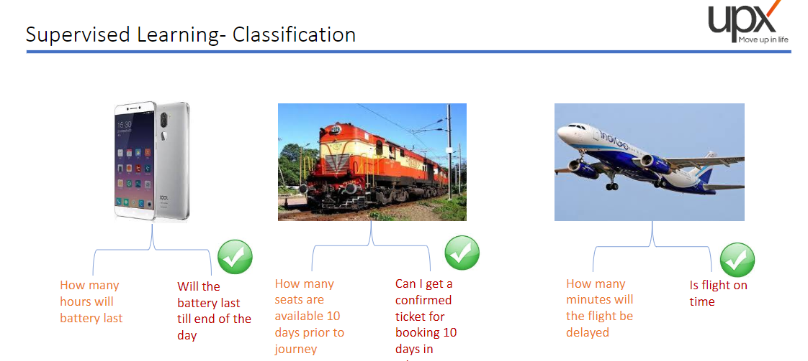
22

Slide 22
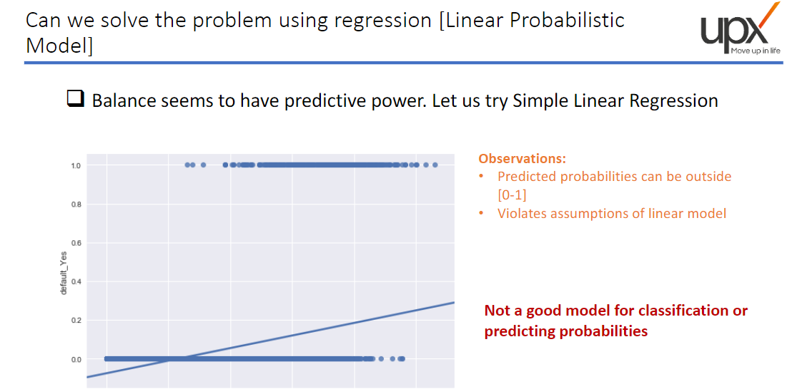
22

Slide 23
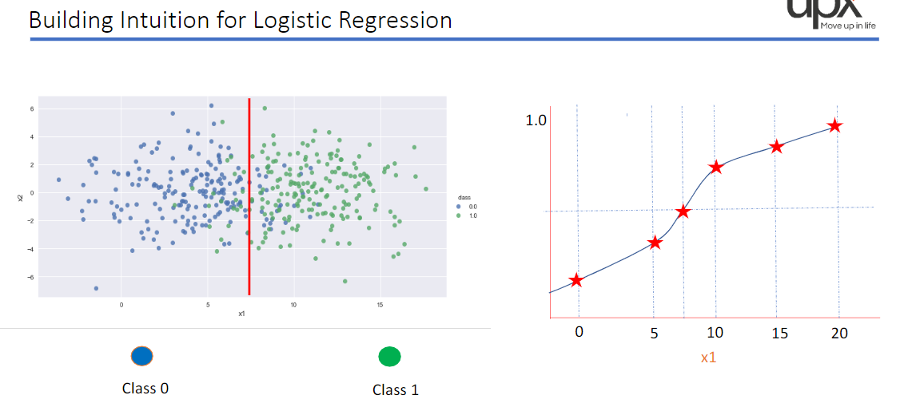
22

Slide 24
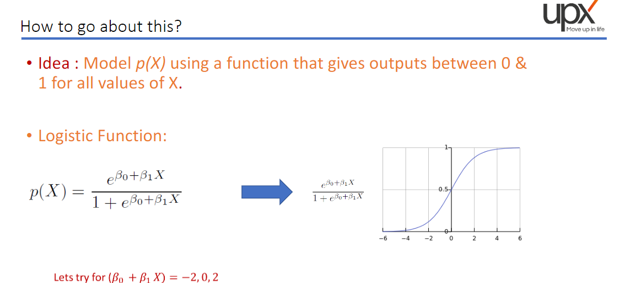
22

Slide 25
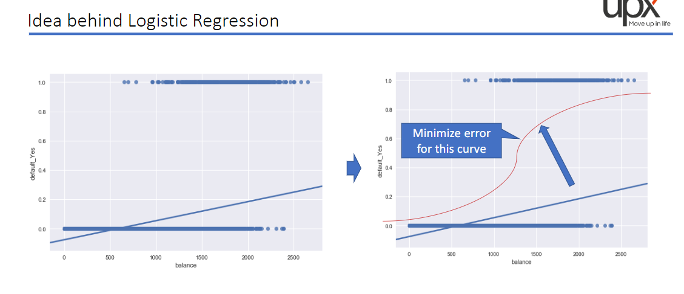
22

Slide 26
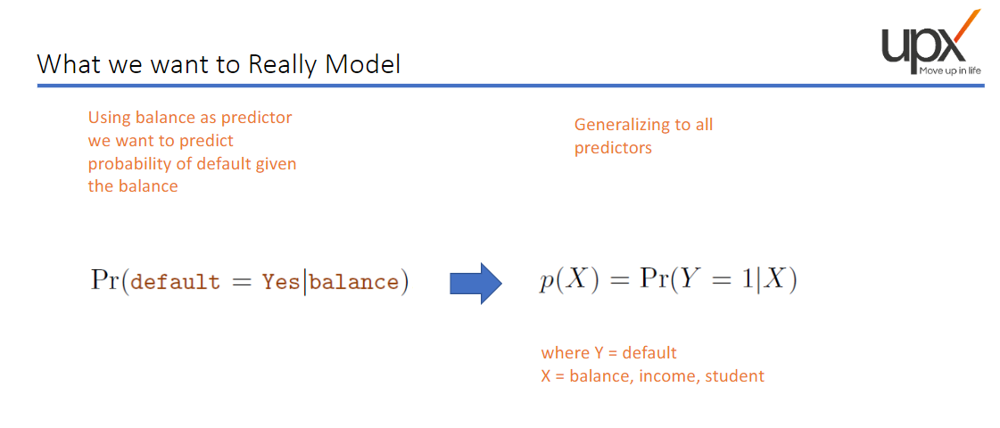
22

Slide 27
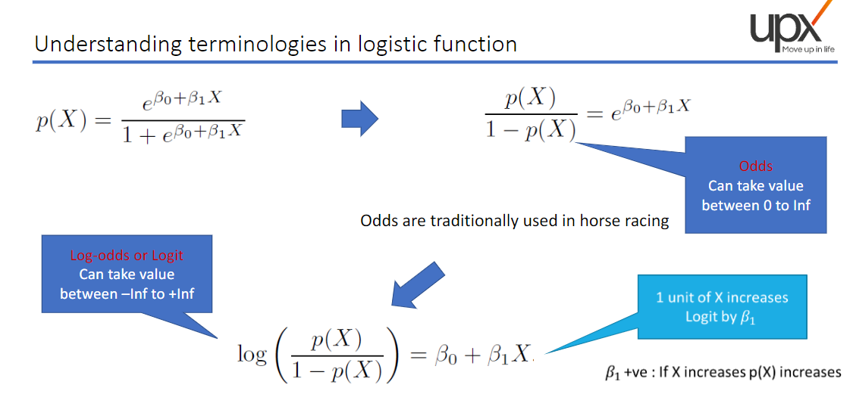
22

Slide 28
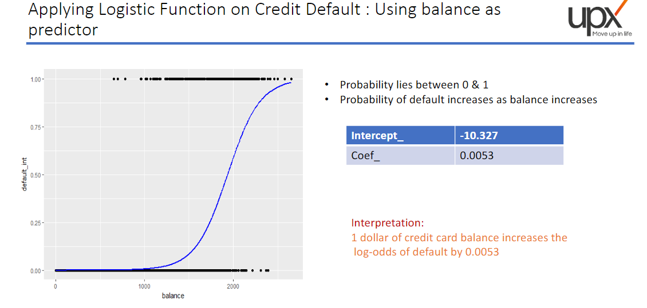
22

Slide 29
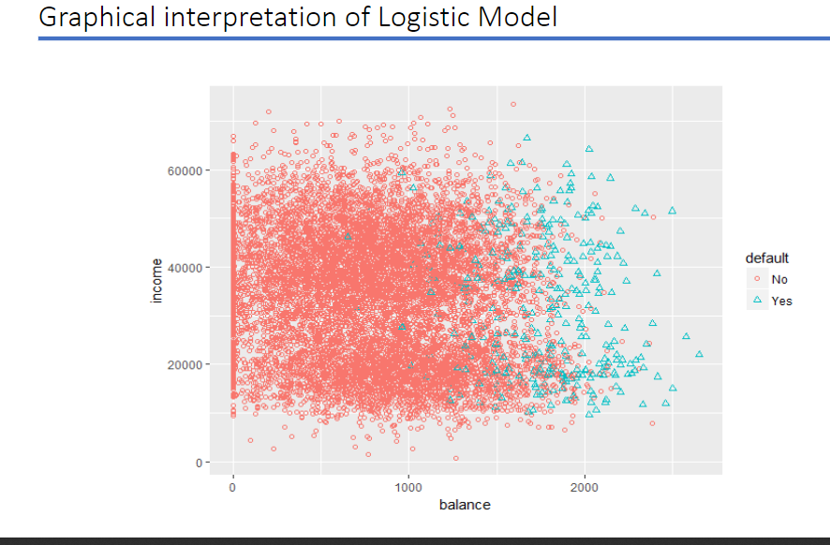
22

Slide 30
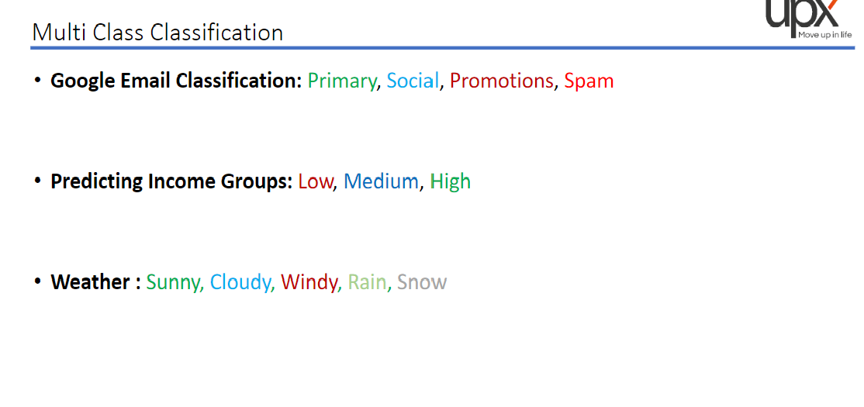
22

Slide 31
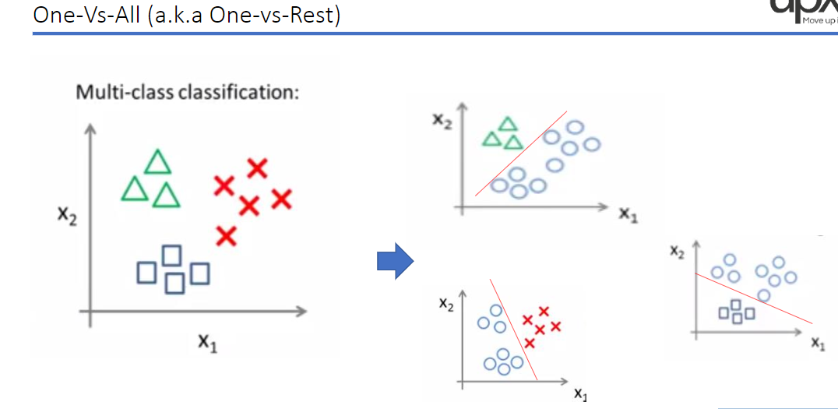
22

Slide 32
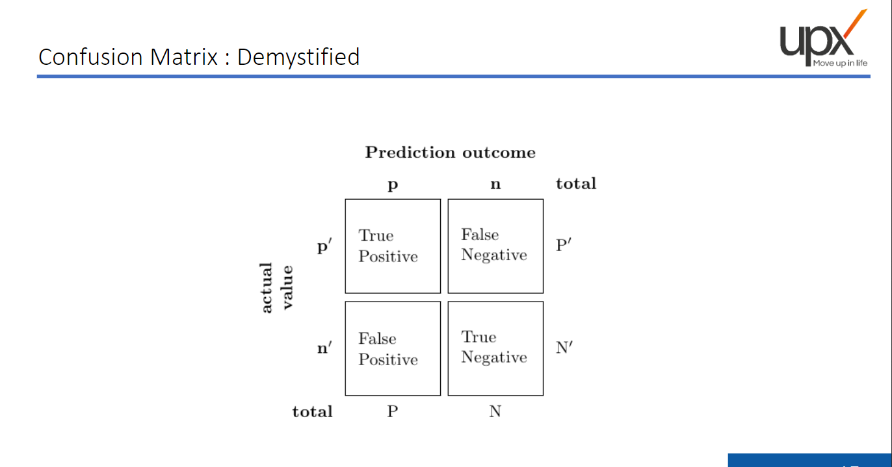
22

Slide 33
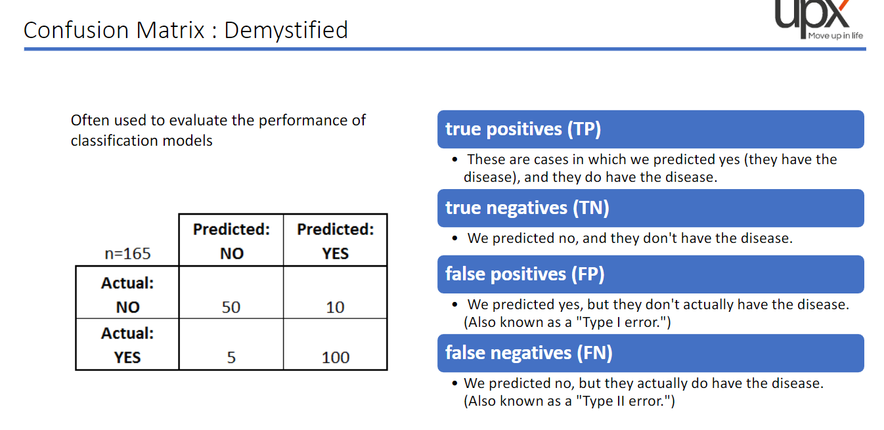
22

Slide 34
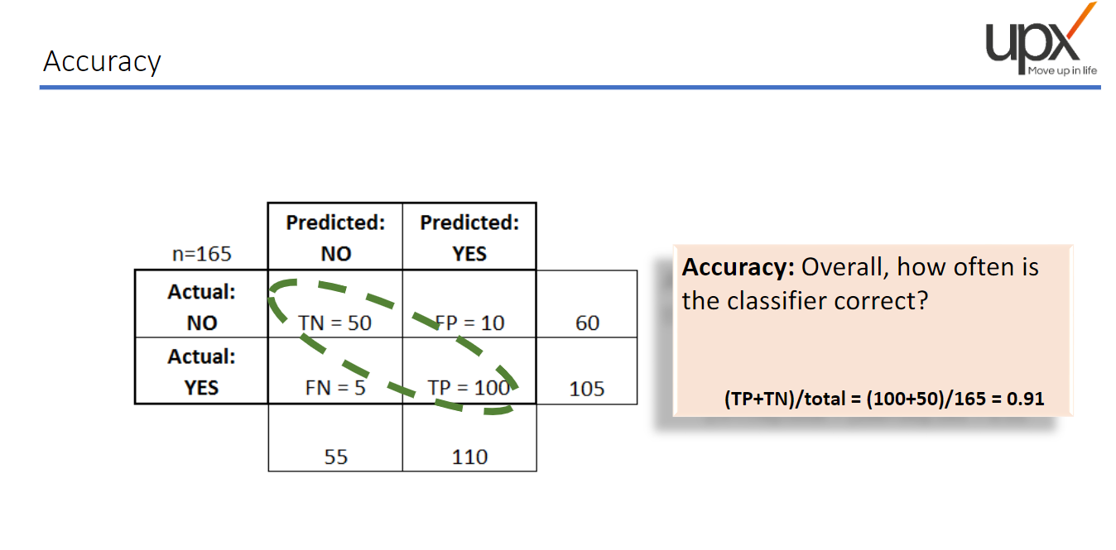
22

Slide 35
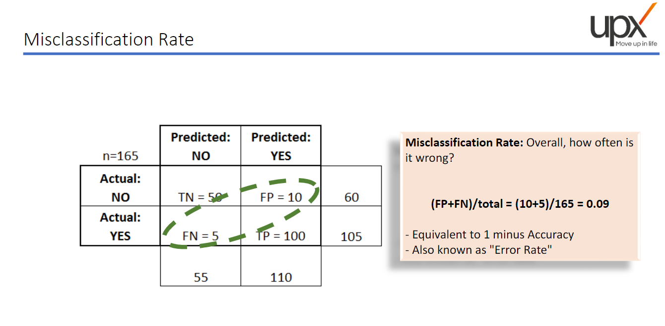
22

Slide 36
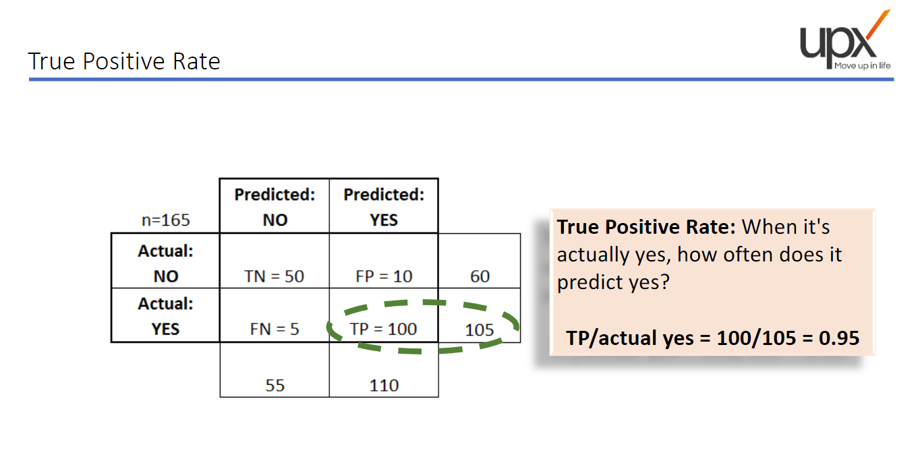
22

Slide 37
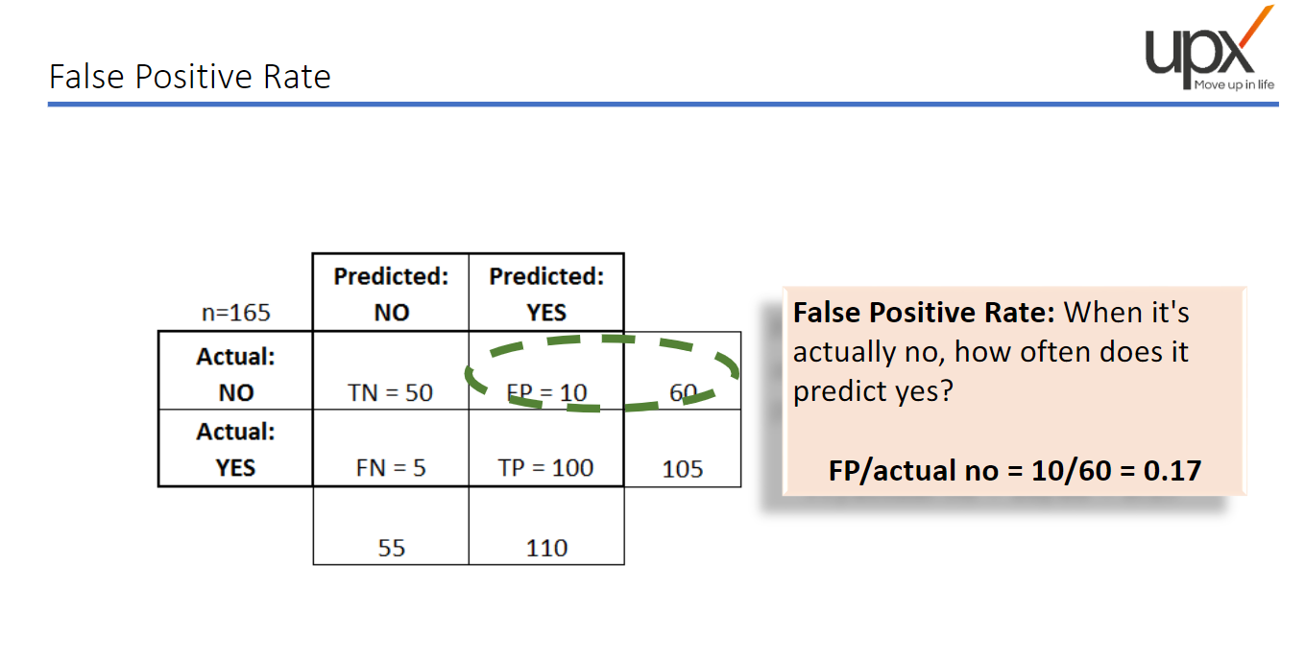
22

Slide 38
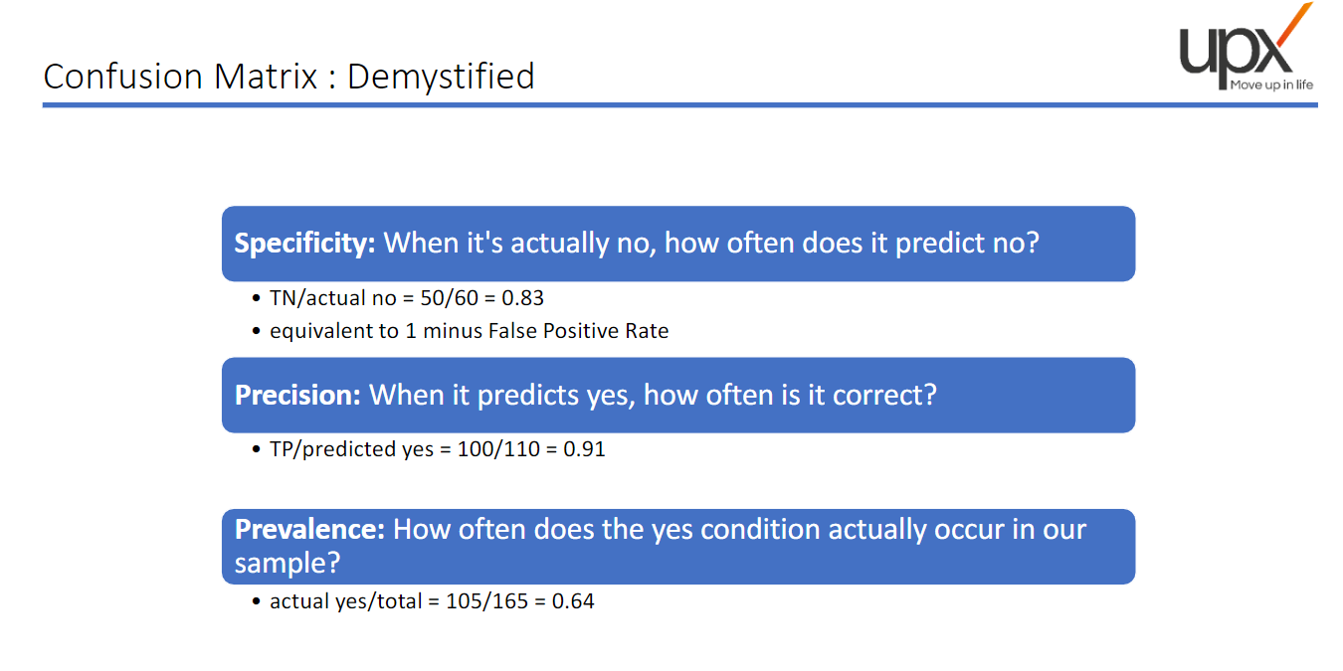
22

Slide 39
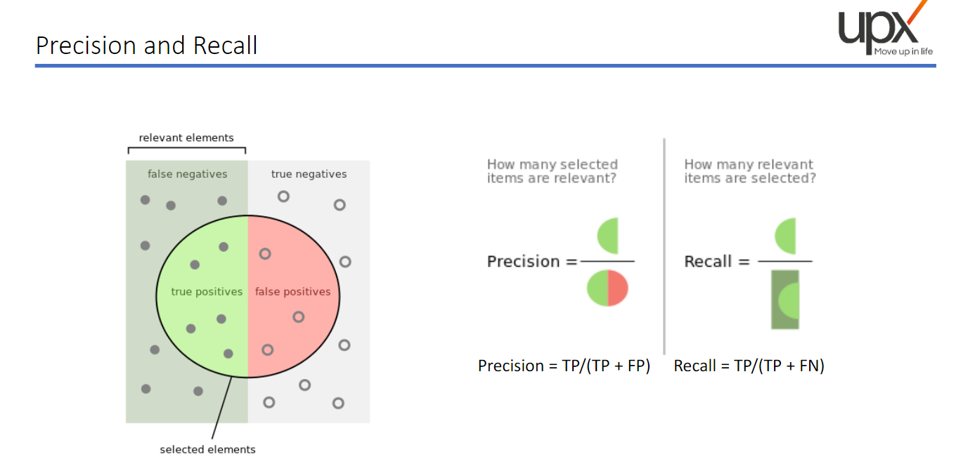
22

Slide 40
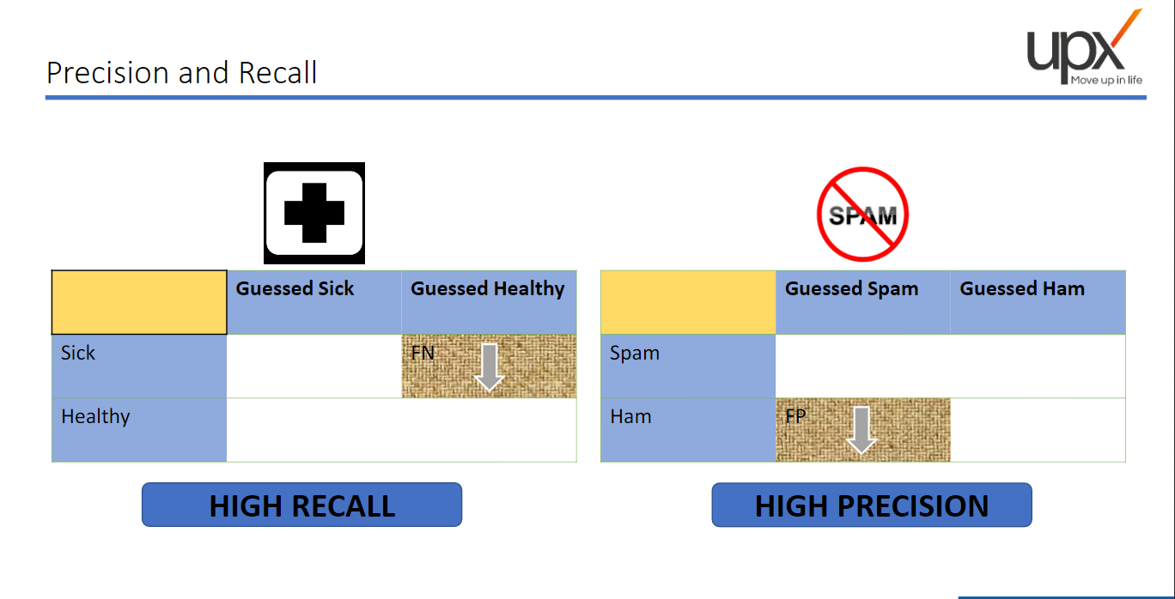
22

Slide 41
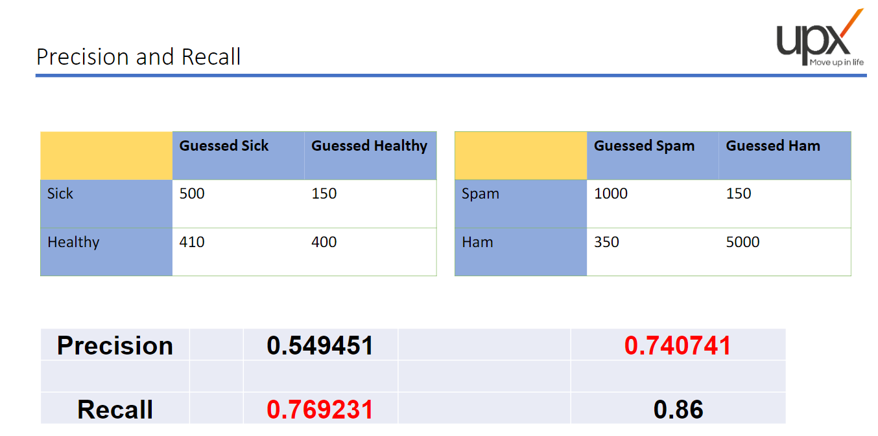
22

Slide 42
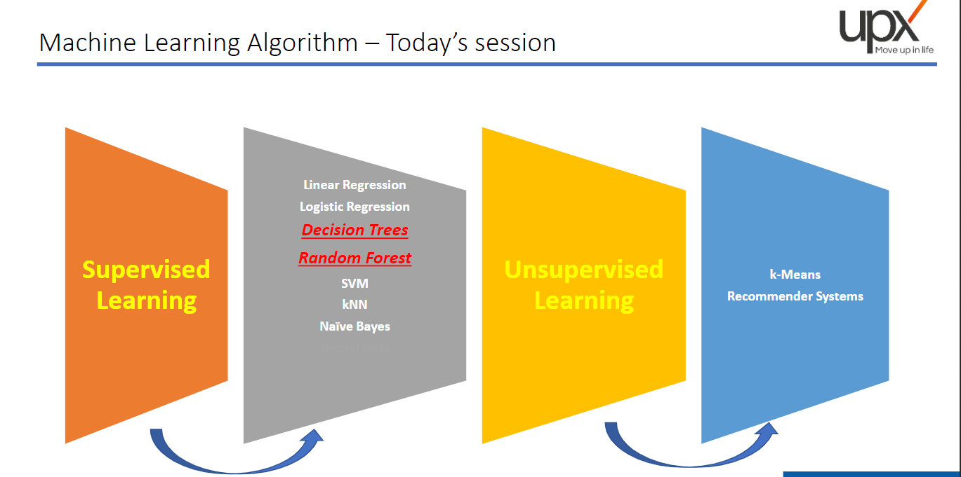
22

Slide 43
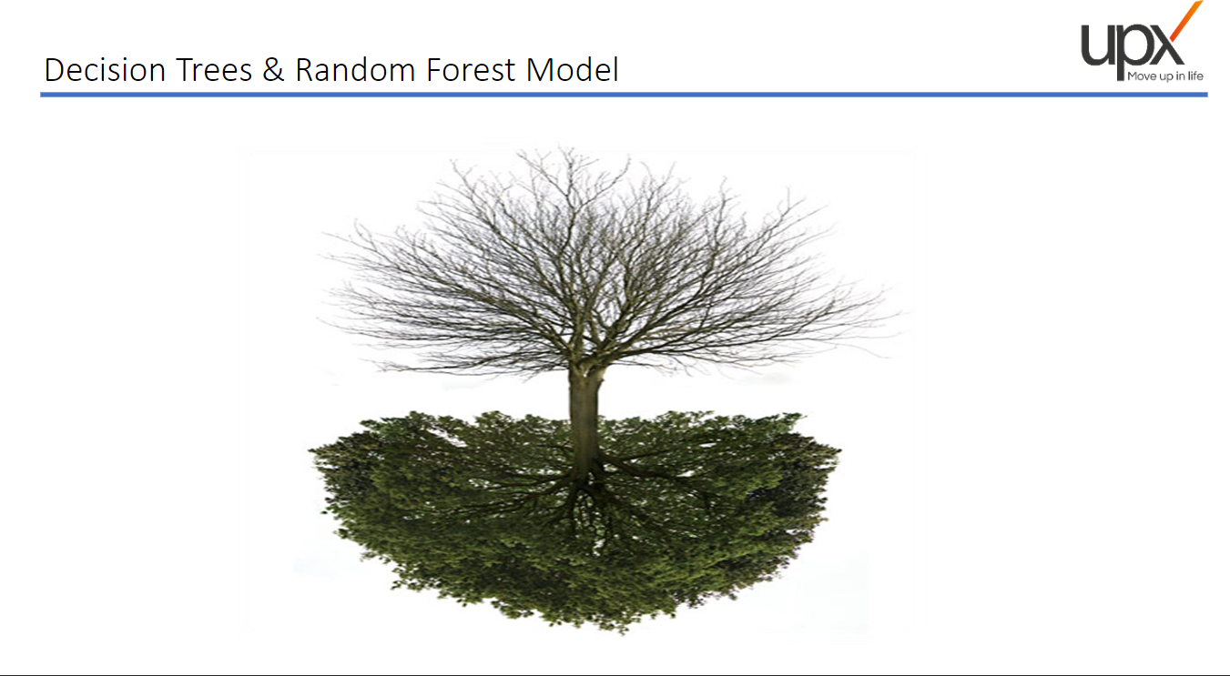
22

Slide 44
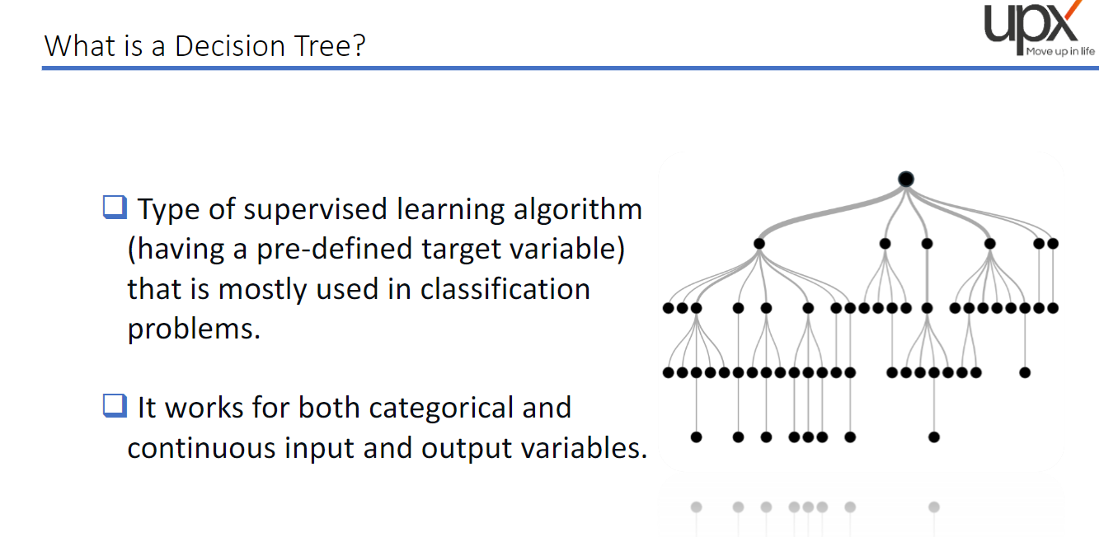
22

Slide 45
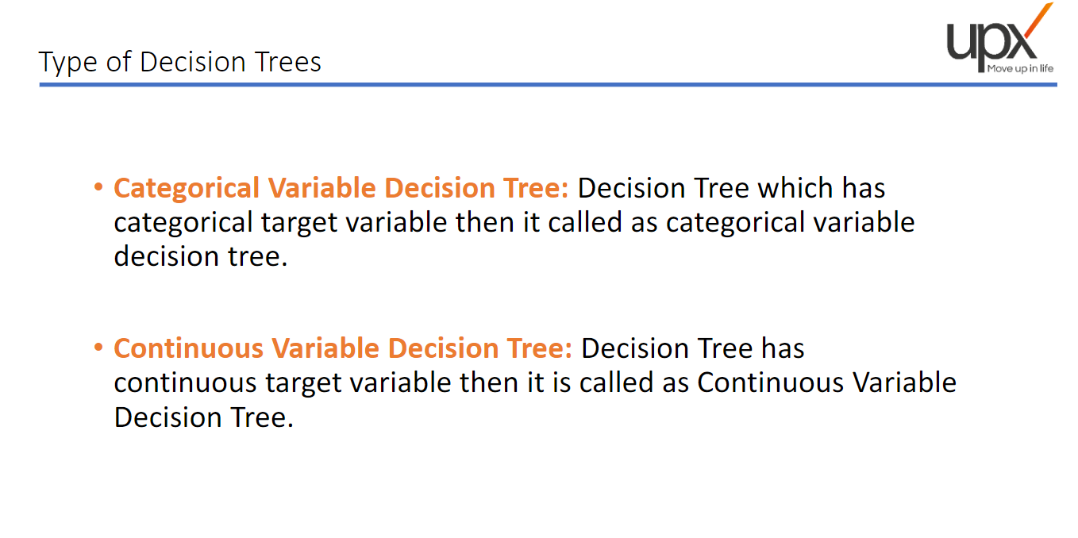
22

Slide 46
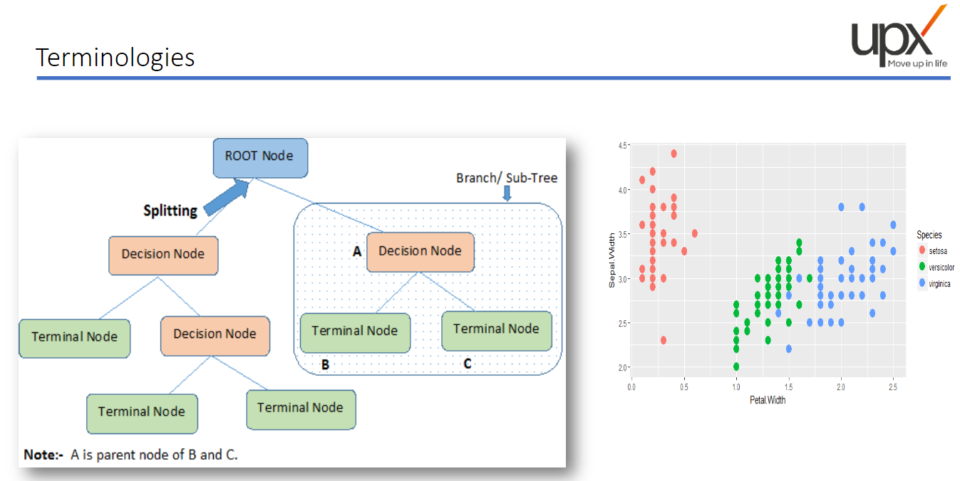
22

Slide 47
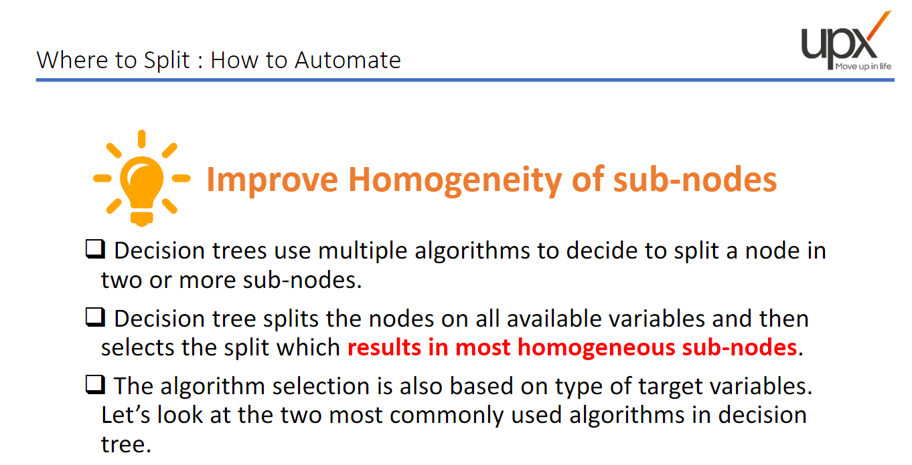
22

Slide 48
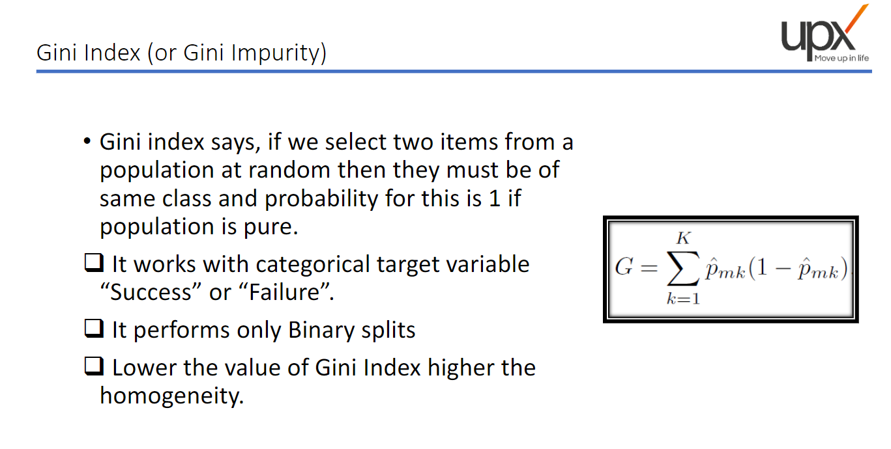
22

Slide 49
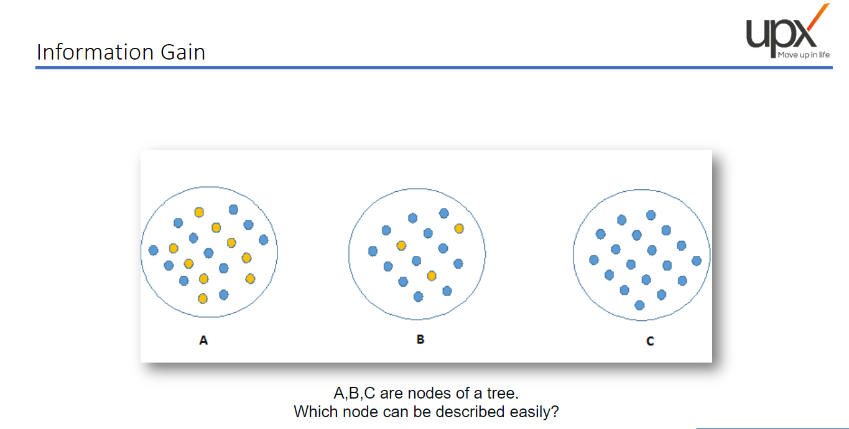
22

Slide 50
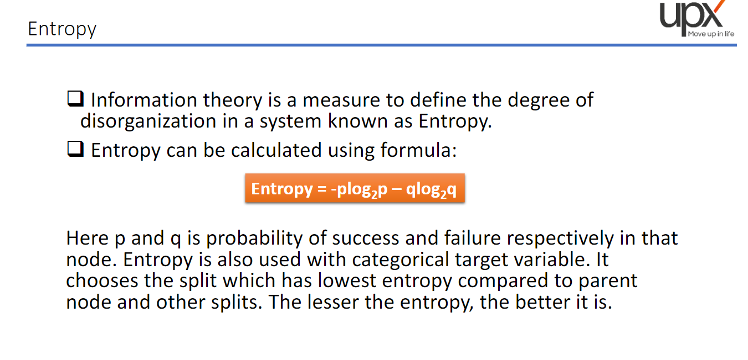
22

Slide 51
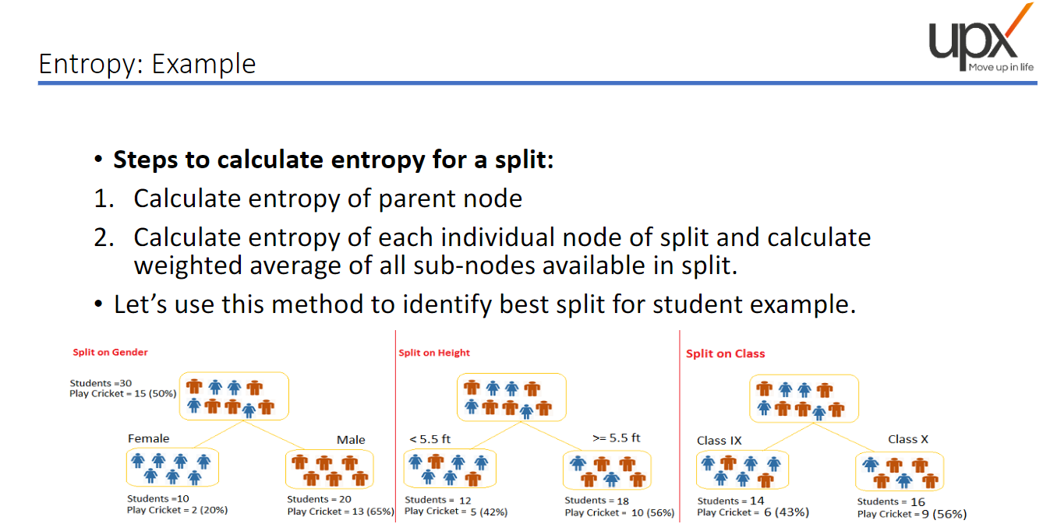
22

Slide 52

22

Slide 53

22

Slide 54

22

Slide 55

22

Slide 56

22

Slide 57

22

Slide 58


40
26

